Slide 1


AI for Early Detection
Prepared by
Name – Rudani Devenkumar Rajeshbhai
Enrollment No - 220670107079
Guided By – Prof. Lipi Kothari
Computer Engineering
SAL INSTITUTE OF TECHNOLOGY AND ENGINEERING RESEARCH

Slide 2
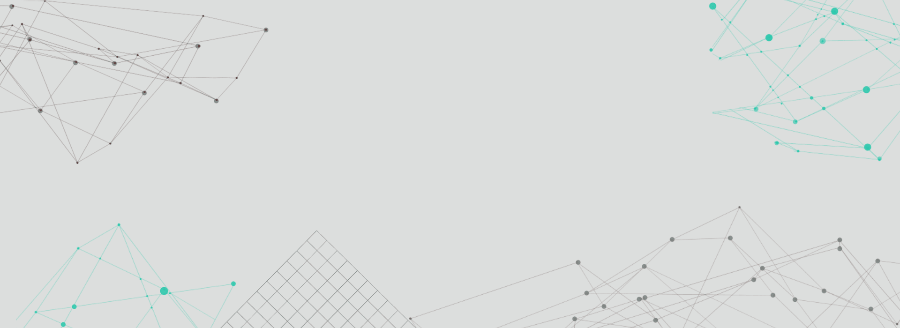


Microsoft Elevate :-
Microsoft Elevate is part of Microsoft’s global initiative focused on empowering learners, students, and professionals with in-demand AI, cloud, and data skills in an AI-driven economy. It brings together Microsoft’s education, technology support, and skill development efforts to help people grow and succeed with cutting-edge tools and real-world learning opportunities.
Organized by: Microsoft in partnership with FICE.

Slide 3
Roles and Responsibilities
Key Responsibilities:
• Study how CBC blood parameters relate to disease prediction • Build machine learning models to analyze CBC data • Develop an AI-based system for disease prediction • Implement OCR to extract parameters from CBC reports • Create dashboards for visualization of CBC analysis • Identify abnormal blood parameters automatically • Generate health reports based on predictions • Work with web technologies to integrate ML models into the application

Slide 4
Introduction to the Project
Overview:
Blood tests provide critical information about human health. However, analyzing CBC reports manually can be time-consuming.
This project builds an AI-based healthcare system that automatically analyzes CBC parameters and predicts possible diseases
What is This Project?
• A machine learning based healthcare web application • Predicts diseases using CBC parameters • Extracts CBC values from uploaded reports using OCR • Highlights abnormal blood parameters • Provides graphical analysis of patient history

Slide 5
Project Goals
1. Build an Intelligent Recommendation Engine
Use machine learning models to analyze CBC parameters and predict possible diseases.
2. Implement Sentiment Analysis
Use machine learning models to analyze CBC parameters and predict possible diseases.
3. Conduct Exploratory Data Analysis
Study blood parameter trends and correlations with diseases
4. Create an Analytics Dashboard
Visualize patient health records and CBC trends
5. Ensure Deployment Ready System
Develop a Streamlit based web application for real-time analysis.
Design a responsive and clean interface

Slide 6
Objectives of the Project
1. Technical
• Develop machine learning models for disease prediction • Implement OCR based CBC parameter extraction • Build a web application using Streamlit • Integrate database for storing patient history
2. Business
• Develop machine learning models for disease prediction • Implement OCR based CBC parameter extraction • Build a web application using Streamlit • Integrate database for storing patient history
3. Learning
• Improve early disease detection • Reduce manual analysis of blood reports • Provide quick health insights for users

Slide 7
Key Functionalities
• User registration and login system • Manual CBC parameter input • Upload CBC report (PDF/Image) • Automatic OCR extraction of CBC values • AI-based disease prediction • Highlight abnormal blood parameters • Patient history tracking • Graphical visualization of CBC trends • Downloadable PDF health report

Slide 8
Methodology / Tools & Technology Used
1. Backend Development:
Python – Core programming language Streamlit – Web framework
2. Machine Learning & NLP:
Scikit-learn – Disease prediction models TensorFlow – Neural network models
3. Data Processing:
Scikit-learn – Disease prediction models TensorFlow – Neural network models
4. OCR technology:
Tesseract OCR PyTesseract
5. Database:
SQLite – Patient data storage
6. Data Visualiztion:
Matplotlib Seaborn

Slide 9
Phase 1: Foundation Building
Week 1
1
Problem identification and project planning
2
Week 2
Problem identification and project planning
Week 3
3
Dataset collection and research
4
Week 4
Data preprocessing and cleaning
Week 5
5
Exploratory data analysis of CBC parameters
6
Week 6
Feature selection and engineering

Slide 10






Phase 2: Model Development & Delivery
Week 7
Machine learning model selection
Week 8
Optimize model parameters
Week 9
Optimize model parameters
Week 10
Evaluate prediction accuracy
Week 11
Improve model performanceCompare different models and select best one
Week 12
Compare different models and select best one

Slide 11
Conclusion
The AI-Based CBC Disease Prediction System demonstrates how machine learning and OCR technology can improve healthcare diagnostics.
The system automatically analyzes CBC reports, identifies abnormal blood parameters, and predicts possible diseases.
It provides a user-friendly interface for health monitoring and generates clear visual insights and reports.
This project highlights the potential of AI-driven healthcare applications in supporting early diagnosis and improving medical decision-making

Slide 12
References
Scikit-Learn Documentation – https://scikit-learn.org
TensorFlow Documentation – https://www.tensorflow.org
Tesseract OCR Documentation – https://tesseract-ocr.github.io
Kaggle Medical Datasets – https://www.kaggle.com
Machine Learning in Healthcare Research Papers

Slide 13
Thank You

